Slide 1
Wireshark Day 2
The Handsome Seastars

Slide 2
Ethernet / ARP
The Handsome Seastars

Slide 3
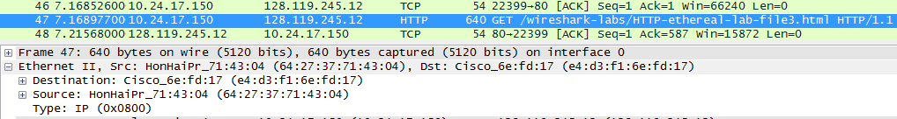
Ethernet / ARP
The GET request shows the source (my computer) has an address of 64:27:37:71:43:04, but the destination (e4:d3:f1:6e:fd:17), after some searching, is actually the router here. In addition, the Type (0x0800) means that the protocol used was IPv4

Slide 4
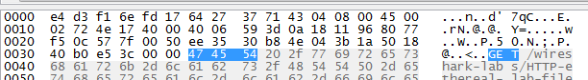
Ethernet / ARP
Also, by knowing that every hex number is a byte, and by counting, we can see that the ‘G’ in GET is 54 bytes from the beginning of the frame

Slide 5

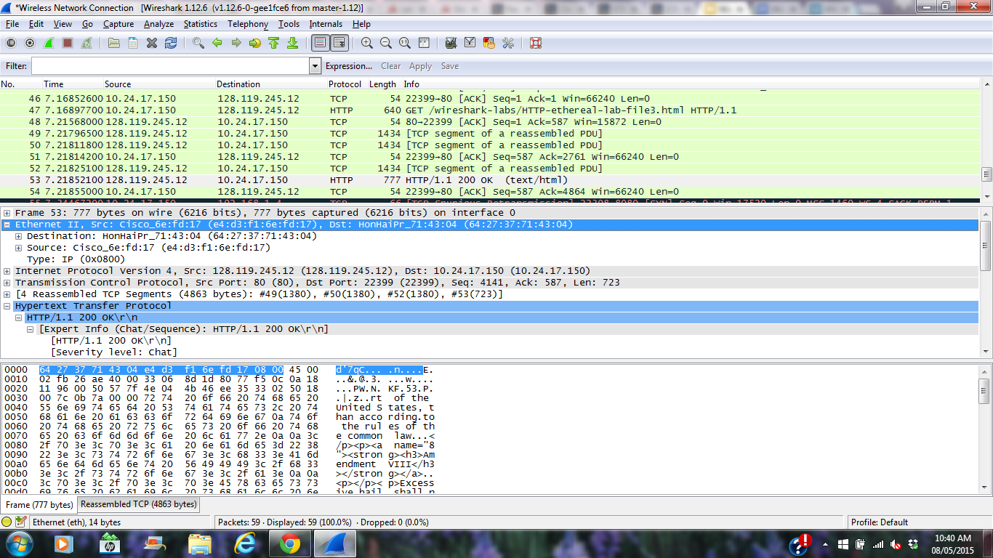
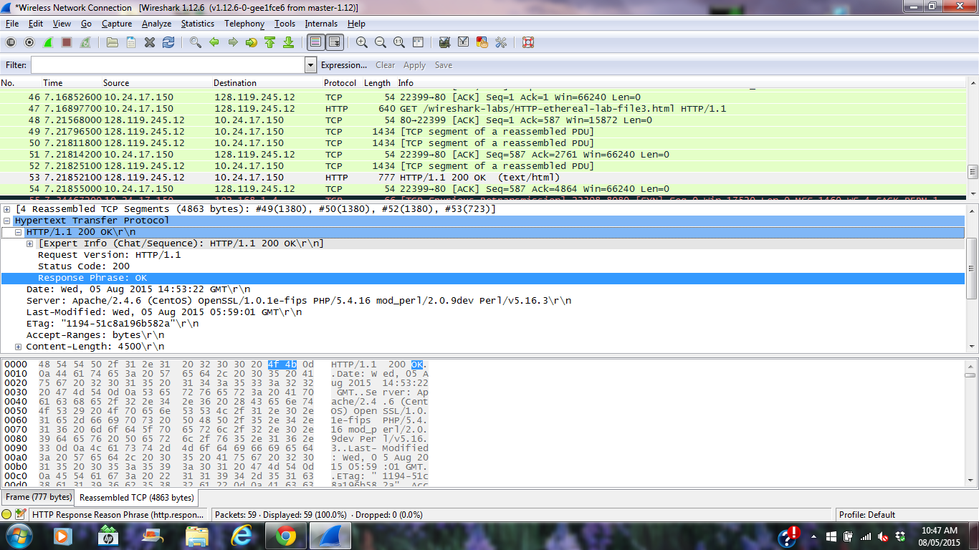
Ethernet / ARP
For the response, the SRC is, again, my router, the DST is my computer, the protocol type is IPv4, and the ‘O’ is 13 bytes away from the beginning . Everything is great! (Awesome)

Slide 6
SSL
The Handsome Seastars

Slide 7
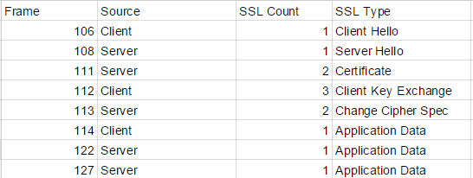
First 8 Analysis
The first Eight packets each contain information to start communication with the server.

Slide 8
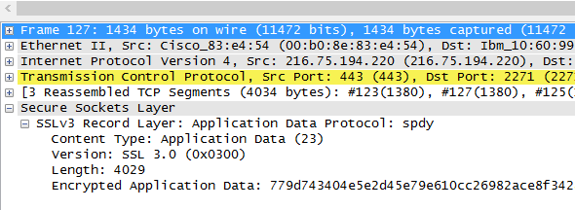
Packet Info Fields
Under an SSL Packet -> Secure Sockets Layer -> SSLv3 Record Layer there are 3 fields on every SSL Packet
Content Type : 1 Byte
Version: 2 Bytes
Length:2 Bytes

Slide 9
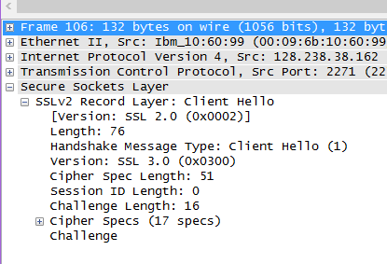
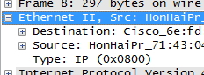
Client Hello Record
With the ClientHello Packet selected the Handshake Message Type field is available with the entry as: Client Hello (1)
Expanding ‘Ethernet’ reveals that the packet was transferred via type ‘0x0800’, also known as IPv4

Slide 10
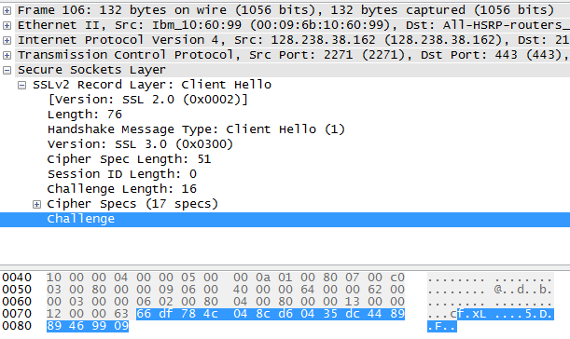
Client Hello Challenge
The ClientHello contains Challenge data but it is not a field, the raw packet data contains the hexadecimal
The number is: 66df 784c0 48cd 60435 dc44 8989 4699 09

Slide 11
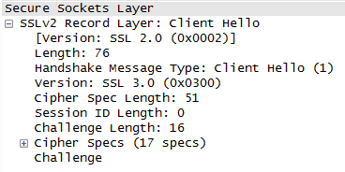
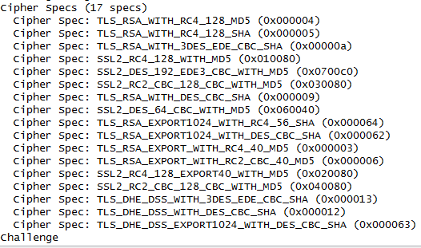
ClientHello Suites Ad
The first suite uses RSA for public key crypto, RC4 for the symmetric-key cipher and uses the MD5 hash algorithm.

Slide 12
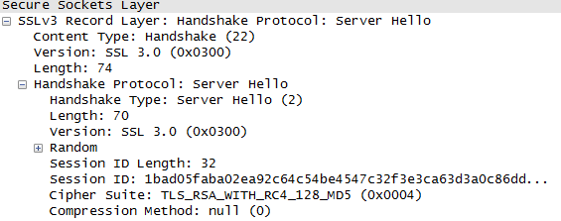
ServerHello SSL Record
The cipher suite uses RSA for public key crypto, RC4 for the symmetric-key cipher and uses the MD5 hash algorithm

Slide 13
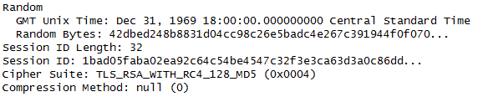
ServerHello Challenge
Yes, this record does include a nonce listed under Random. The nonce is 32 bits long, 28 for data and 4 for the time. The purpose is to prevent a replay attack.

Slide 14
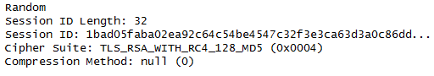
ServerHello Session ID
Yes it does. It provides a unique persistent identifier for the SSL session which is sent in the clear. The client may resume the same session later by using the server provided session ID when it sends the ClientHello.

Slide 15
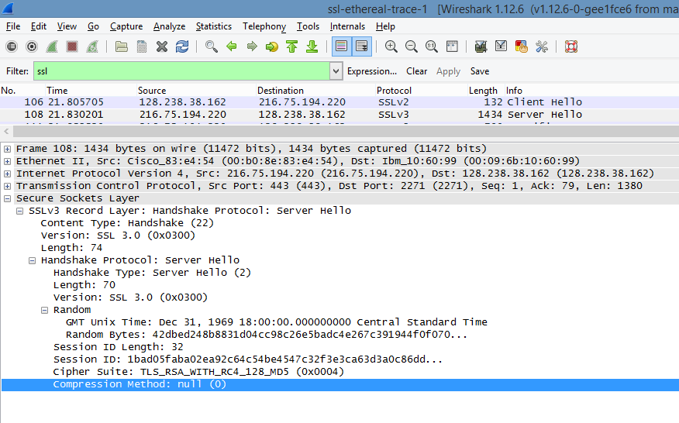
Certificate Record
There is no certificate , it is in a separate record. Yes, the certificate fits into a single frame.

Slide 16
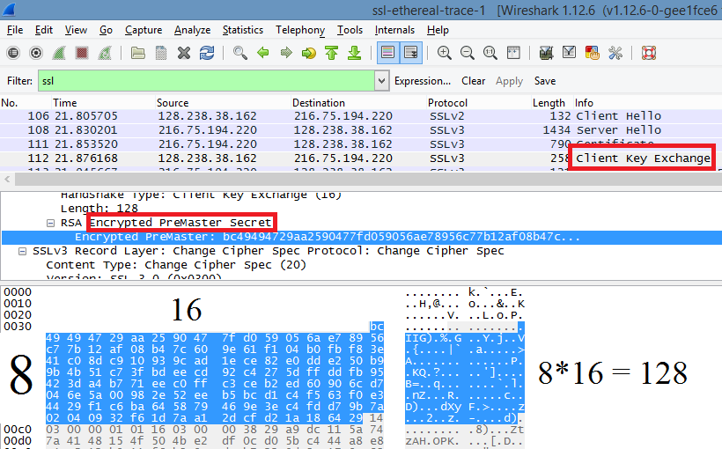
Client Key Exchange Record
It contains a pre master secret, boxed in red. It is used to create a master secret. with the The secret is encrypted with the the public key from the server's certificate, it is 128 bytes long.

Slide 17
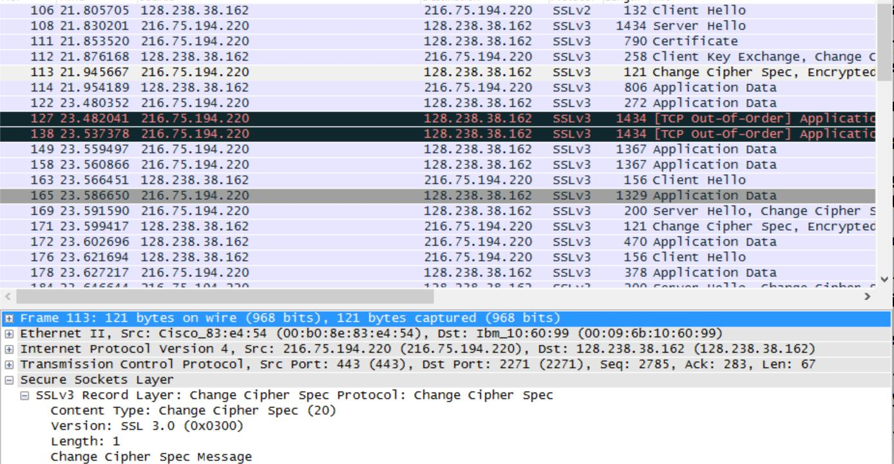
Change Cipher Spec Record
Indicates that the contents of the following SSL Record will be encrypted. This record is 6 bytes long; 5 for header, 1 for message
In this example, the length of the Change Cipher Spec Record is shown as 1 byte.

Slide 18
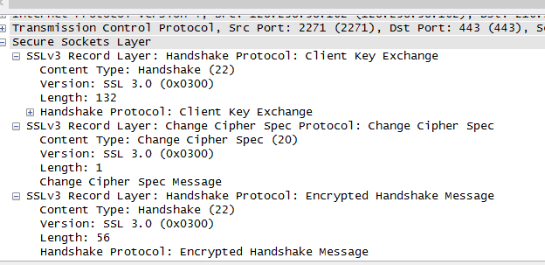
Encrypted Handshake Record
In the encrypted handshake record a MAC of all previous handshakes done by the client is sent to the server.

Slide 19
Change Cipher Record
The Server sends an encrypted handshake and a change cipher record to the client. However the server’s record is different from the clients because it contains all the handshakes sent from the server rather than from the client. Because otherwise the records would be the same.

Slide 20
App Data Encryption
App Data is encrypted with symmetric key encryption algorithm chosen in the handshake phase using the pre-master key and challenges from both client and server. Encryption is done when data is first sent, be it from client or from server.

Slide 21
ICMP
The Handsome Seastars

Slide 22
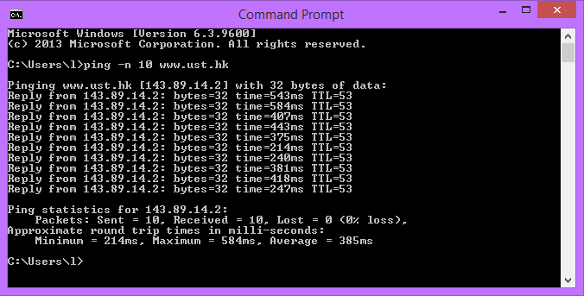
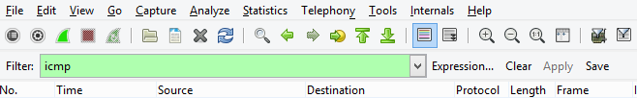
Pinging Ust.hk
Start by begining a capture in wireshark
then in Command Line type: ping -n 10 www.ust.hk
This command pings www.ust.hk 3 times
This generates the ICMP packets we will be looking at, but we only want ICMP Packets
Apply a filter by typing “ICMP” to the filter field at the top of wireshark. Then “Apply”

Slide 23
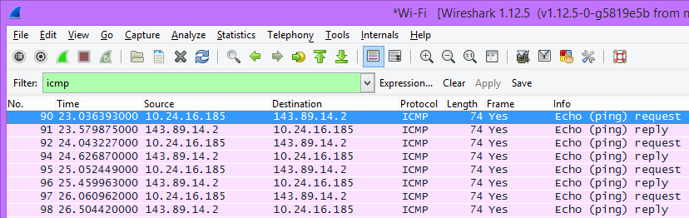
IP Addresses
Pack #90, the first ICMP from the ping shows the Source (This Computer)’s IP: 10.24.16.185
It shows the Destination (www.ust.hk)’s IP: 143.89.14.2

Slide 24
Port Numbers & ICMP
Port numbers are how the Transport Layer recognizes to which program packets belong. ICMPs are not a Transport Layer packet. They are a Network Layer packet. So when we ping an IP like before, we didn’t ping a port. We pinged the IP.
TL;DR: ICMP’s are above port numbers

Slide 25
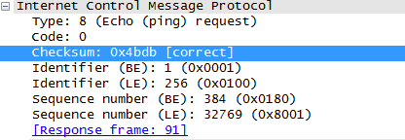
Request Packet Examination
Looking at the packet’s fields under Internet Control Message Protocol we can find some information
ICMP Type and Code #
Type: 8 (Echo (ping) request)
Code: 0
Bytes of Checksum
0x4bdb [correct]
Sequence Number
BE: 384
LE: 22769
Identifier Field
BE: 1
LE: 256

Slide 26
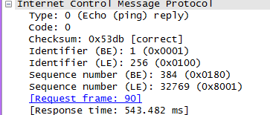
Reply Packet Examination
Now we are going to look at the same information on a reply packet. fun.
ICMP Type and Code #
Type: 0 (Echo (ping) reply)
Code: 0
Bytes of Checksum
0x53db [correct]
Sequence #
BE: 384
LE: 32769
Identifier Field
BE: 1
LE: 256

Slide 27
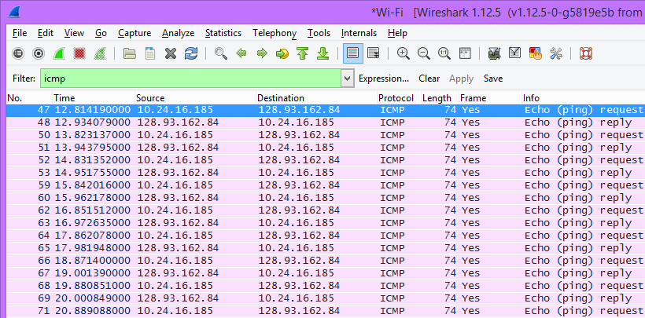
New Capture
Repeating the process for www.ust.hk except this time for www.inria.fr
This uses the command: ping -n 10 www.inria.fr
This generates several new ICMP packets. Joy...

Slide 28
Host and Destination IPs
As you can see from the first request packets the Source (Our Computer)’s IP is 10.24.16.185. Shockingly enough, it hasn’t changed
The Destination (www.inria.fr)’s IP is 128.93.162.84

Slide 29
ICMP & UDP
If ICMP packets were actually sent as UDP packets like they are in Linux they would not have Protocol number 01, they would have Protocol number 0x11. This is because UDP packets are over the internet layer (IPs) and can go from destination to destination but use ports. However if you are only going from Host A to Host B with no additional information, then ICMP is all that is necessary.
Thats it. Thats all I know. No Questions.

Slide 30
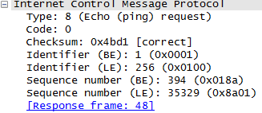
Comparing ICMP Echo Packets
As you can see the differences between the two packets are:
Checksum
Sequence # (BE)
Sequence # (LE)
Response Frame
However all the fields themselves are the same, because they are both the exact same kind of packet.
www.ust.hk
www.inria.fr

Slide 31
ICMP Error Packet
The Error packet and Query packet are not the same, shocking ikr. The Error packet contains both the IP header and the first 8 bytes of the original ICMP packet that the error is for.

Slide 32
Last Three ICMP Packets
ICMP packets are type 0 (Echo message) and not 11 (TTL Expired) because the Type 0’s are the ones that made it without dying.

Slide 33
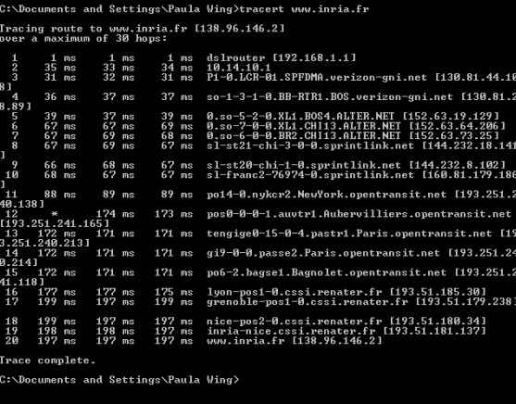
Traceroute
Using the command: tracert www.inria.fr we can see all the steps from our computer to inria.fr
We can also see the ping between the hops. All hops increase a little each time
However from hop 11 to 12 we have a significantly longer delay.
Through some research that hop is from New York to Aubervilliers, France

Slide 34
NAT
The Handsome Seastars

Slide 35
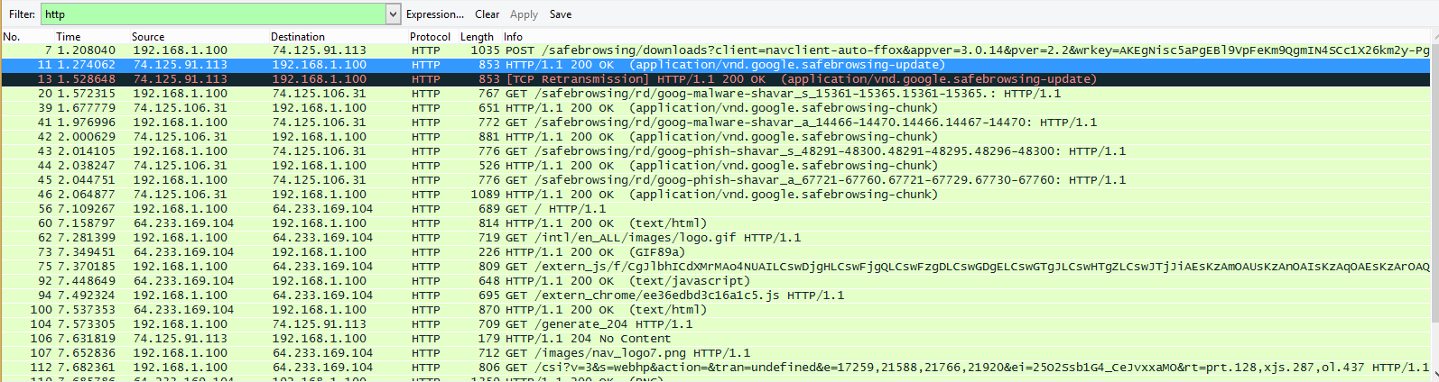
Find the IP address of the client.

Slide 36
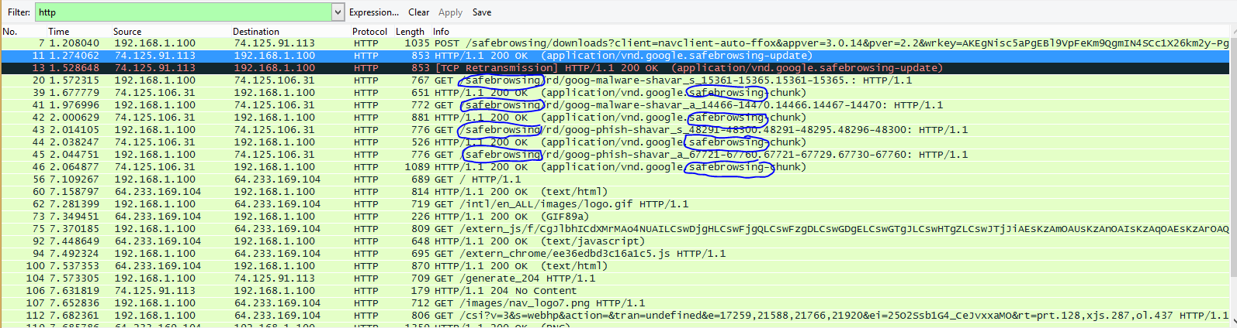
Safe browsing
The client communicates with several different Google servers in order to implement “safe browsing.”

Slide 37
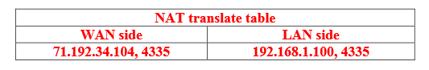
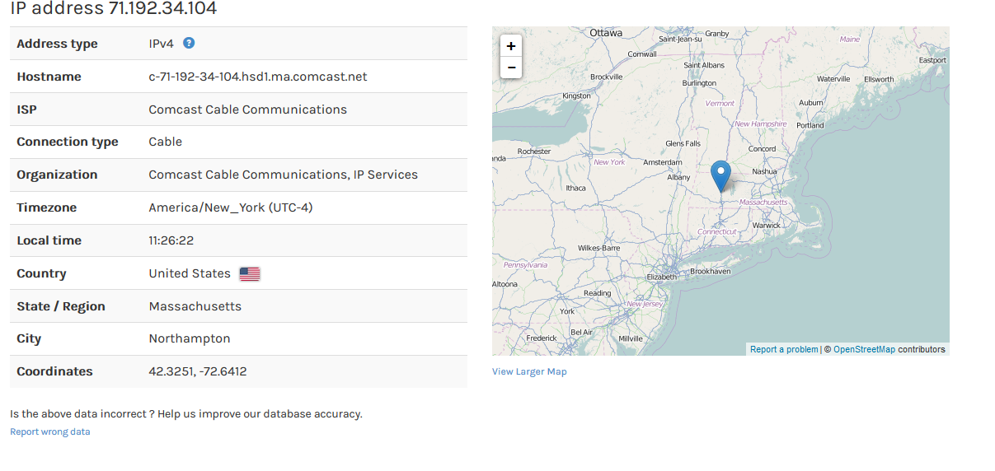
“Whose ip address is ip address.”
192.138.1.100
=
71.192.34.104

Slide 38
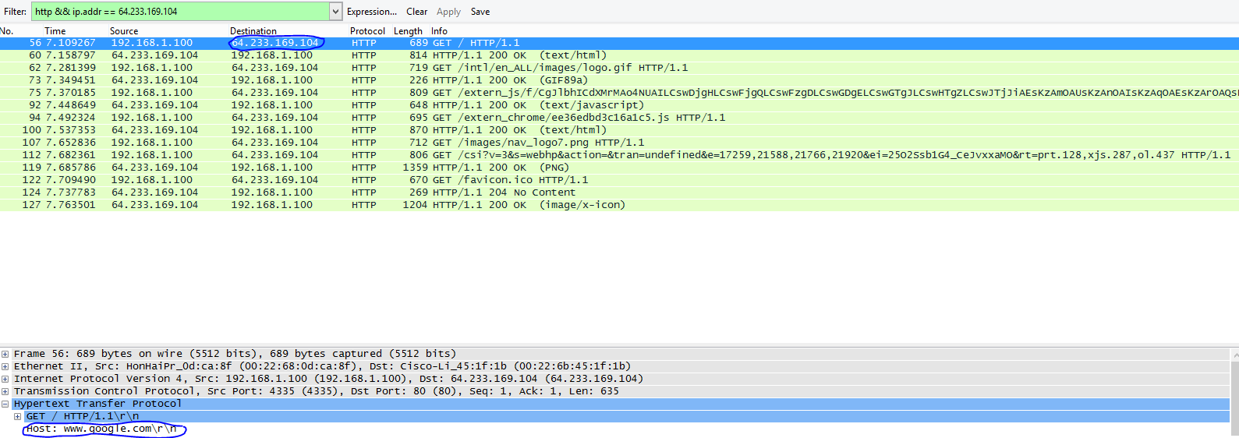
Google

Slide 39
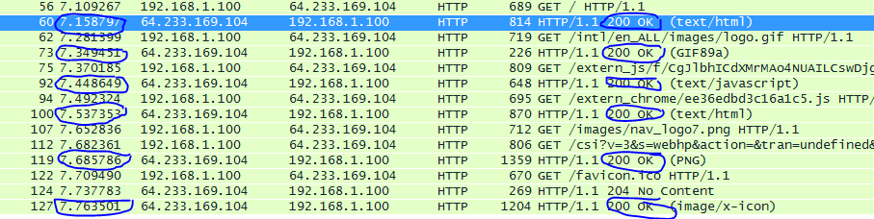
At what time is the corresponding 200 OK HTTP message received from the Google server?

Slide 40
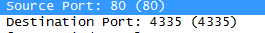
What are the source and destination IP addresses and TCP source and destination ports on the IP datagram

Slide 41
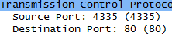
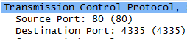
Wireshark
Using the three‐way SYN/ACK handshake. At what time is the client‐to‐server TCP SYN segment
sent that sets up the connection used by the GET sent at time 7.109267? What are the source and destination IP addresses and source and destination ports for the TCP SYN segment? What are the source and
destination IP addresses and source and destination ports of the ACK sent in response to the SYN. At what time is this ACK received at the client? (Note: to find these segments you will need to clear the

Slide 42
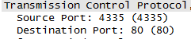
In the NAT_ISP_side trace file, find the HTTP GET message that was sent from the client to the Google server at time 7.109267 (where t=7.109267 is time at which this was sent as recorded in the NAT_home_side trace file). At what time does this message appear in the NAT_ISP_side trace file? What are the source and destination IP addresses and TCP source and destination ports on the IP datagram carrying this HTTP GET (as recording in the NAT_ISP_side trace file)? Which of these fields are the same, and which are different, than in your answer to question 3 above?
The time is 6.069168. Source is 71.192.34.104, 4335 and destination is 64.233.169.104, 80. Only the source IP has changed

Slide 43
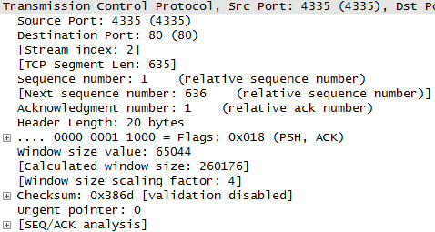
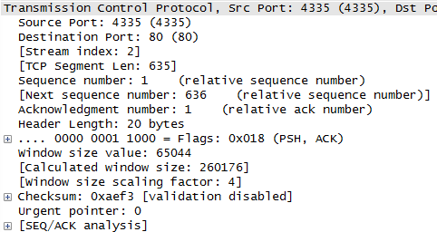
Are any fields in the HTTP GET message changed? Which of the following fields in the IP datagram carrying the HTTP GET are changed: Version, Header Length, Flags, Checksum. If any of these fields have changed, give a reason (in one sentence) stating why this field needed to change.
Only the checksum has changed since the IP source address changed and the checksum includes the value of the source IP

Slide 44
In the NAT_ISP_side trace file, at what time is the first 200 OK HTTP message received from the Google server? What are the source and destination IP addresses and TCP source and destination ports on the IP datagram carrying this HTTP 200 OK message? Which of these fields are the same, and which are different than your answer to question 4 above
The time is 6.308118; the source is 64.233.169.104, 80; the destination is 71.192.34.104, 4335. Only the destination IP has changed

Slide 45
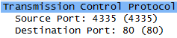
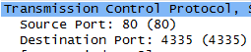
In the NAT_ISP_side trace file, at what time were the client-to-server TCP SYN segment and the server-to-client TCP ACK segment corresponding to the segments in question 5 above captured? What are the source and destination IP addresses and source and destination ports for these two segments? Which of these fields are the same, and which are different than your answer to question 5 above?
The client-to-server TCP SYN time is 6.035475; the source is 71.192.34.104, 4335; the destination is 64.233.169.104, 80; and the server-to-client TCP ACK time is 6.067775; the source is 64.233.169.104, 80; and the destination is 71.192.34.104, 4335. For SYN the source IP changed and for ACK the destination IP changed

Slide 46
802.11
The Handsome Seastars

Slide 47
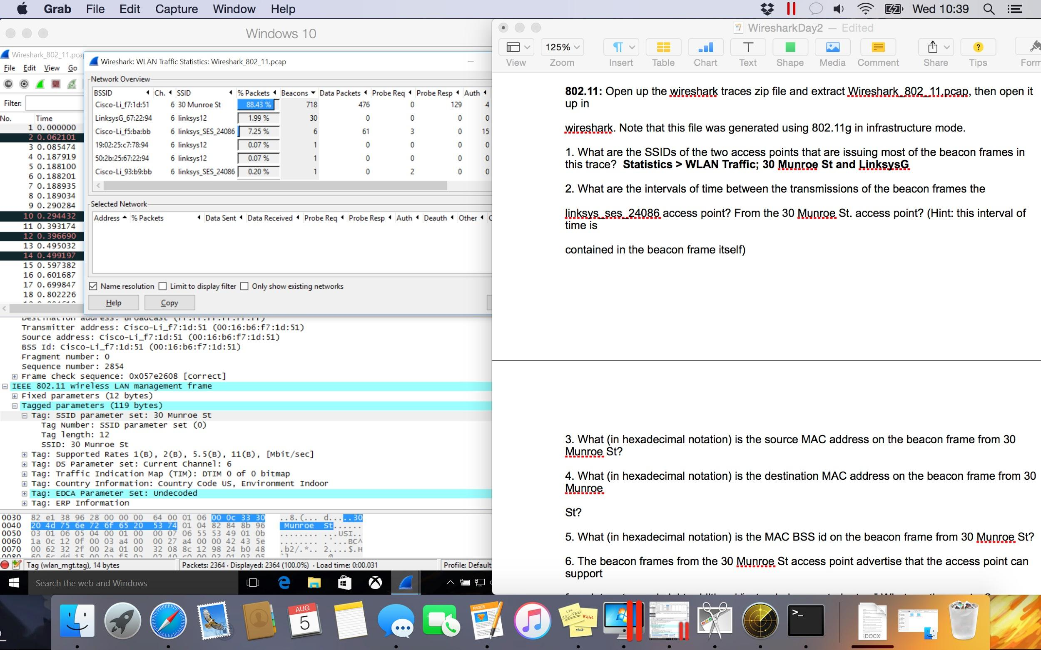
SSIDs of the beacon senders
There’s an easy way!
Statistics > WLAN Traffic
Wait for data to populate
Sort by “Beacons” column
Note SSIDs:
30 Munroe Street
LinksysG...

Slide 48
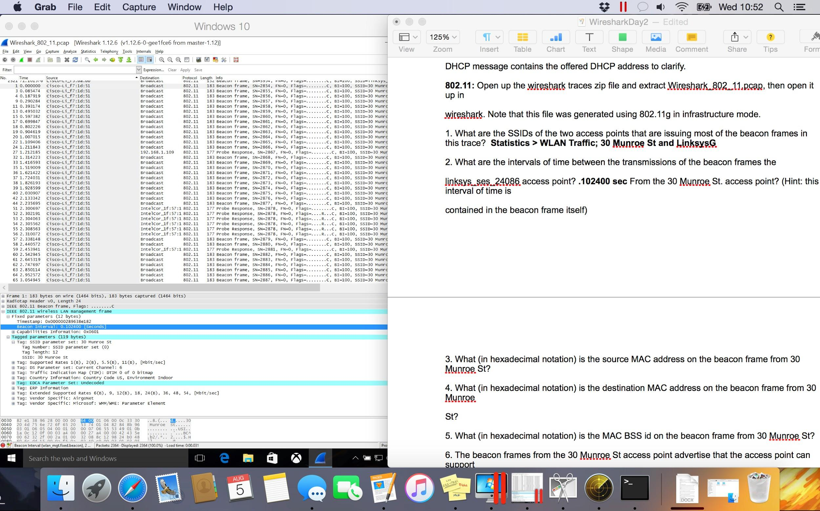
Beacon tx interval: 30 Munroe St
IEEE 802.11 wireless LAN management frame
^{Fixed parameters}
^{Beacon Interval is .102400 sec}
Tagged parameters to verify SSID with MAC address

Slide 49
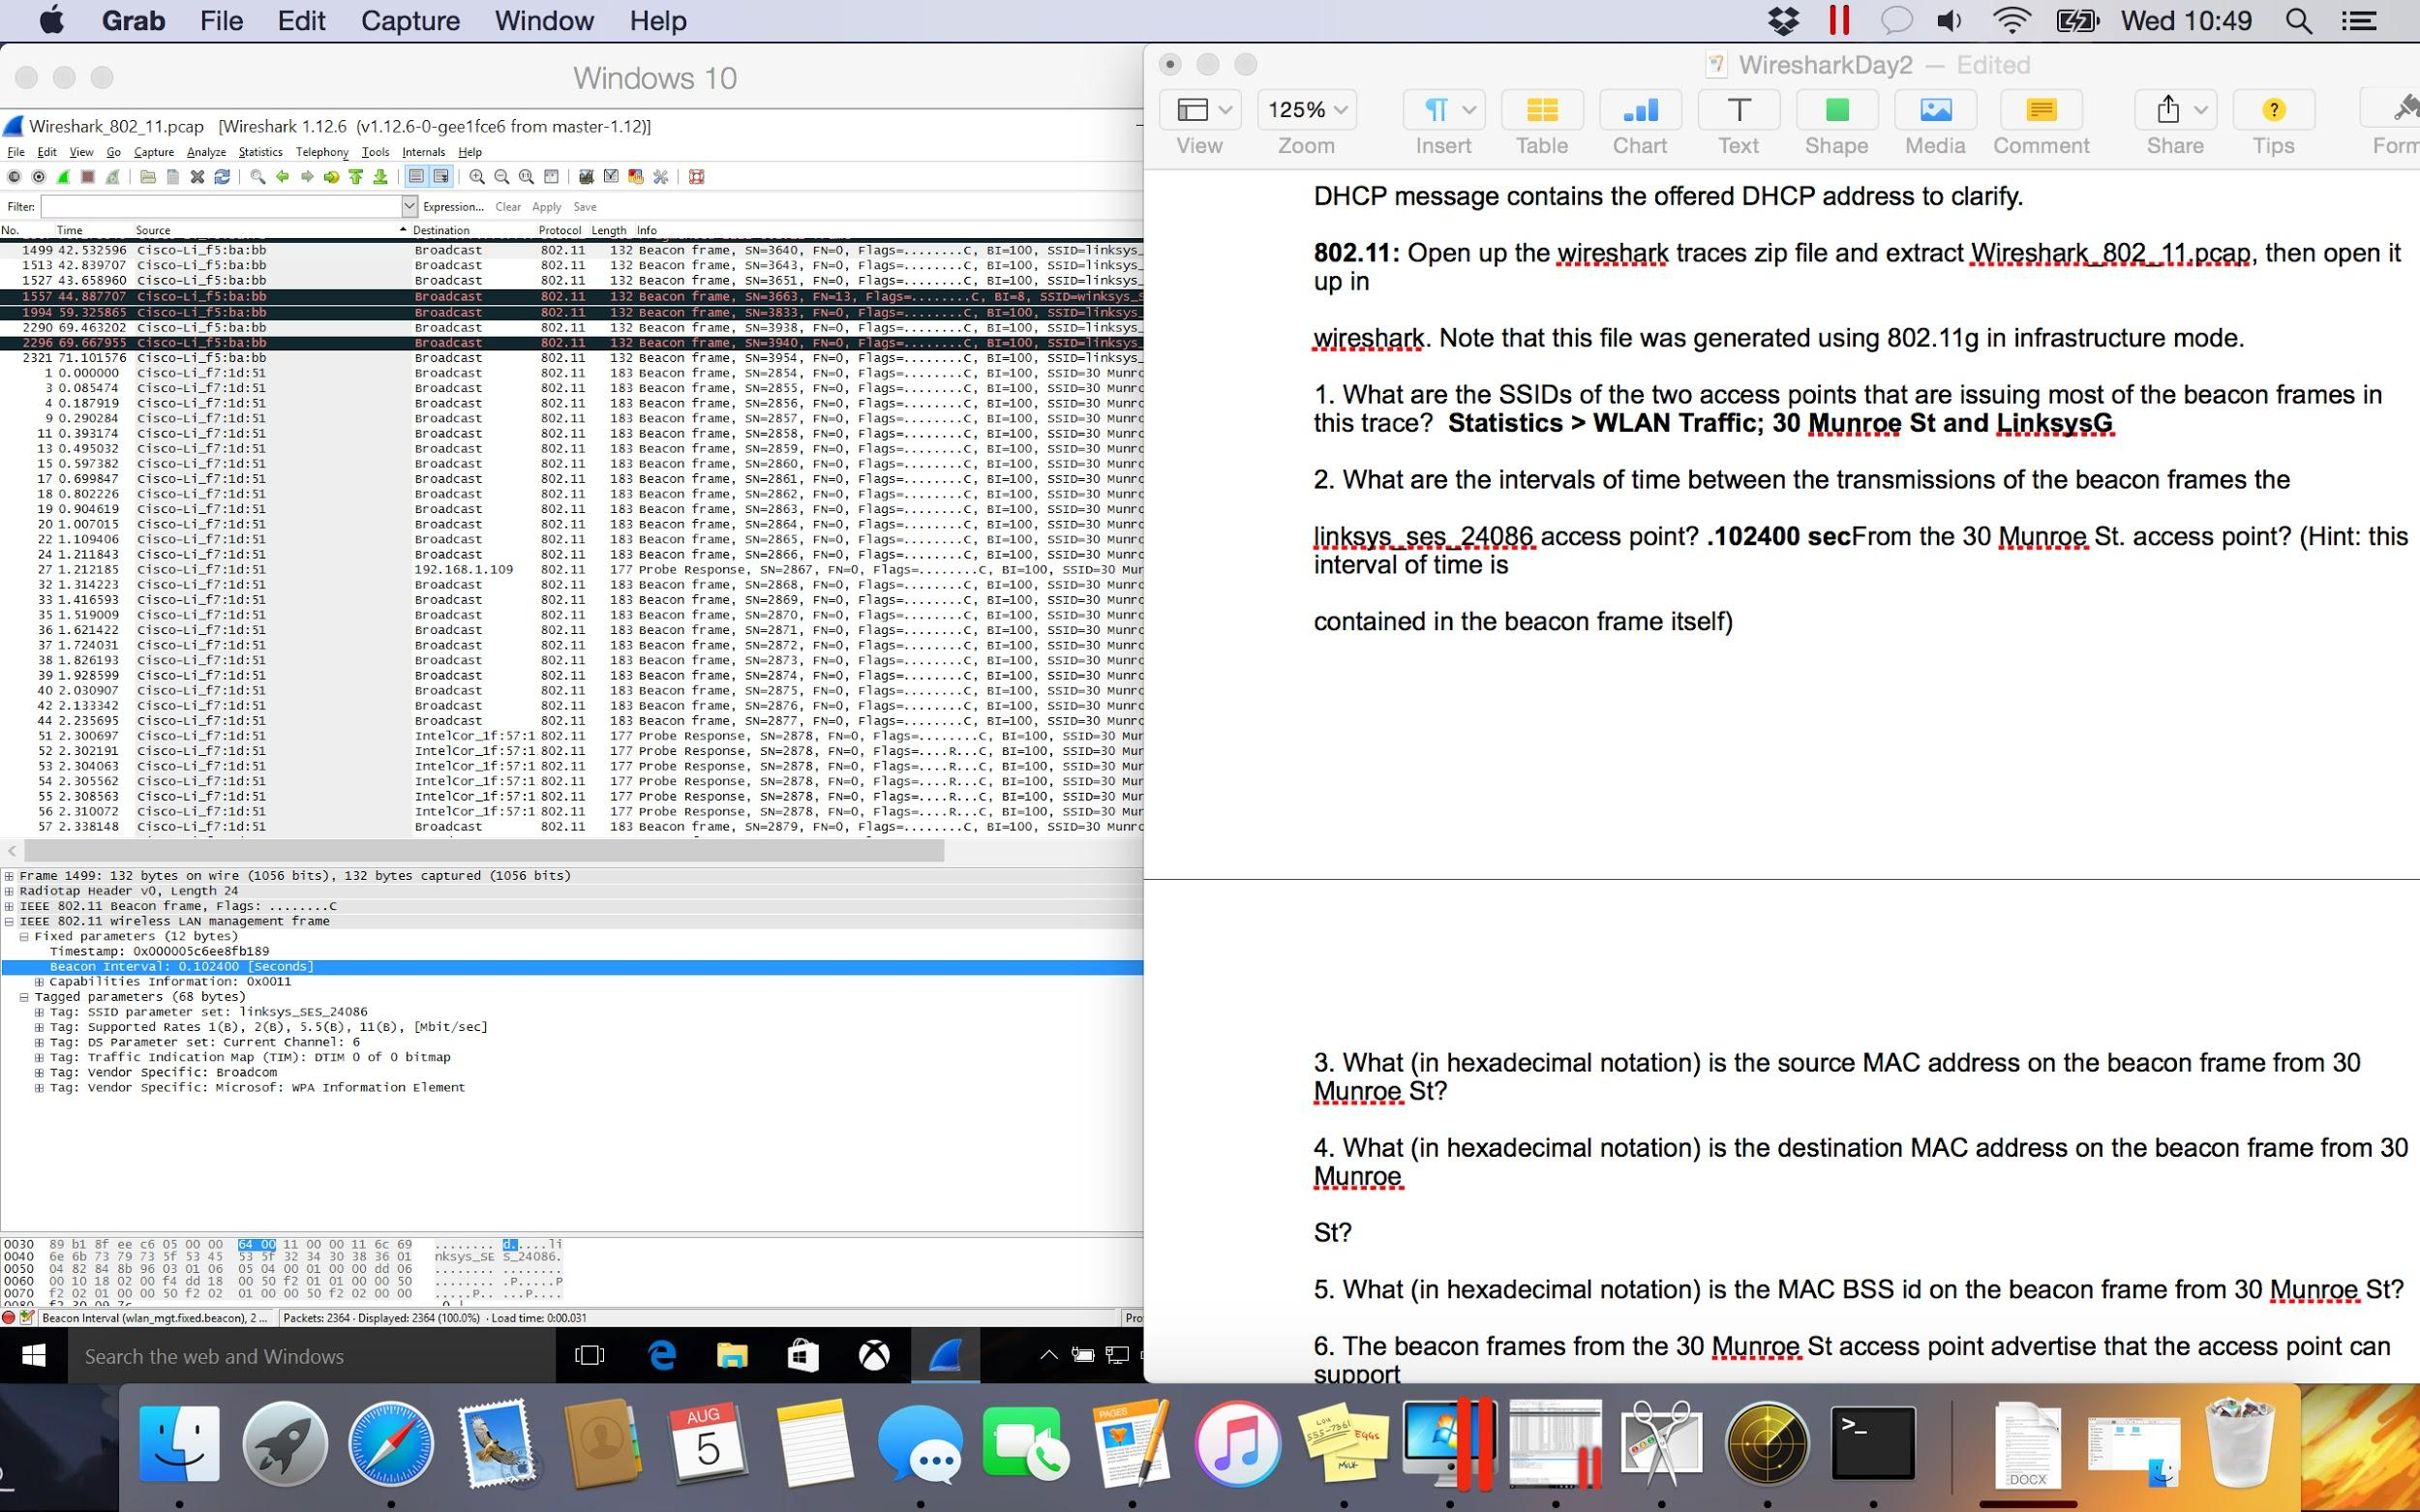
Beacon tx interval: linksys_ses_24086
IEEE 802.11 wireless LAN management frame
^{Fixed parameters}
^{Beacon Interval is .102400 sec}
Tagged parameters to verify SSID with MAC address

Slide 50
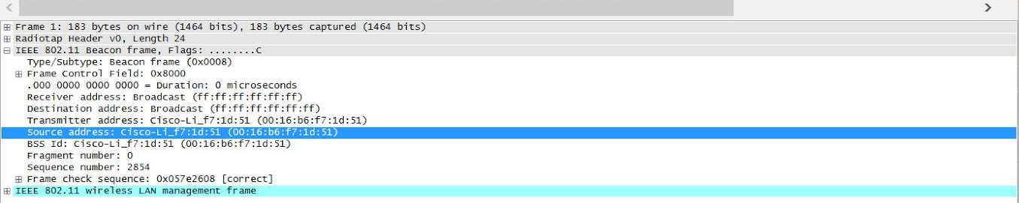
Source MAC, Dest MAC +BSSID of 30 Munroe beacon
We’ve selected a Beacon packet from 30 Munroe St.
Source address: 00:16:b6:f7:1d:51
Destination address: Broadcast (ff:ff:ff:ff:ff:ff)
BSSID: 00:16:b6:f7:1d:51

Slide 51
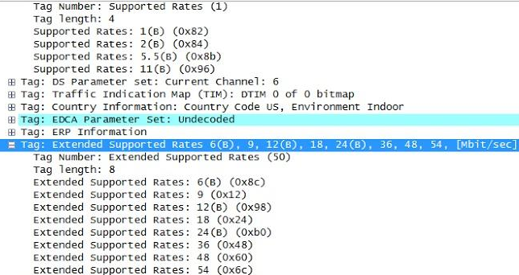
Data rates
IEEE 802.11 wireless LAN management frame
Tagged parameters
Tag: Extended Supported Rates
6(B), 9, 12(B), 18, 24(B), 36, 48, 54 Mbps
30 Munroe St. beacon packet selected

Slide 52
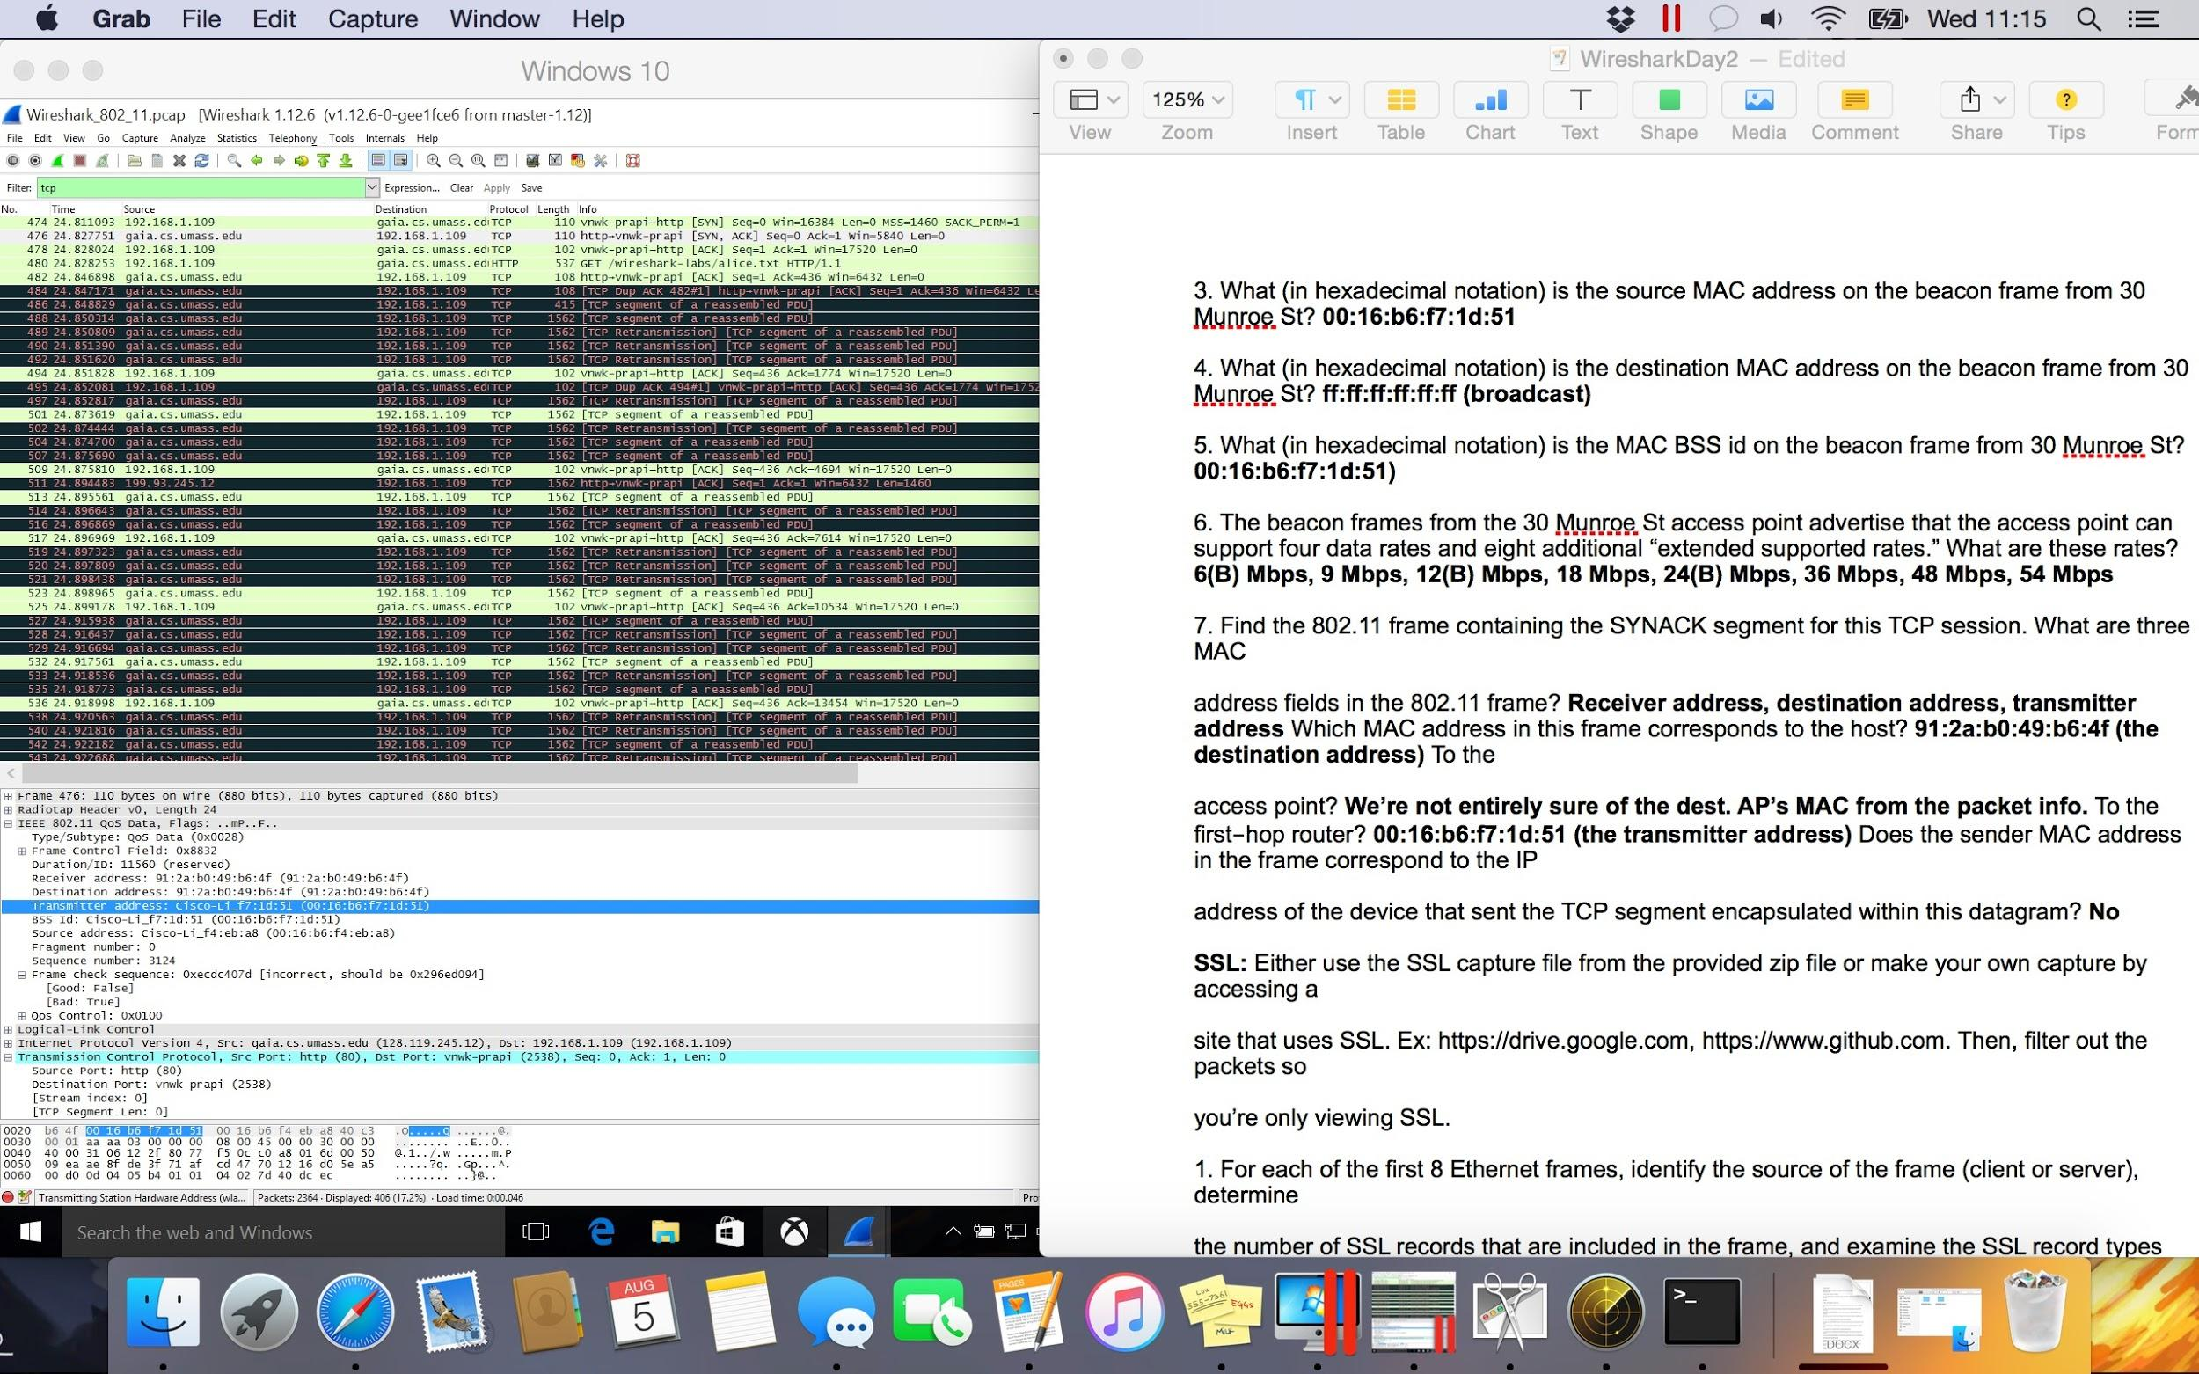
SYN/ACK MAC Addresses
Address fields:
Receiver (host)
Destination (host)
Transmitter
Host’s address is 91:2a:b0:49:b6:4f
First-hop’s address is 00:16:b6:f7:1d:51
Can’t determine AP address from this packet
Frame sender doesn’t correspond to TCP sender

Slide 53
DHCP
The Handsome Seastars

Slide 54
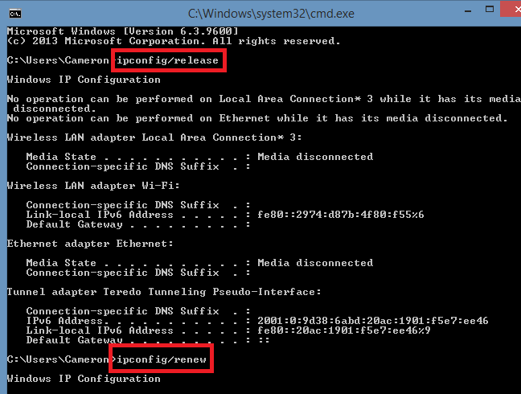
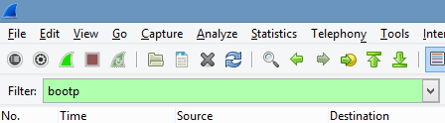
Go into command prompt and type in ipconfig /release before you start up your wireshark
capture. After you do that, start you capture and type in ipconfig /renew into command prompt. To
filter out unnecessary data, use the bootp filter.
Release
Start Wireshark
Renew
Renew
Release
Renew
Stop Wireshark

Slide 55
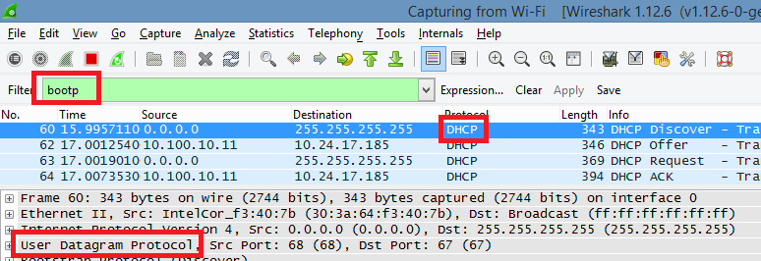
Are DHCP messages sent over UDP or TCP?
UDP

Slide 56
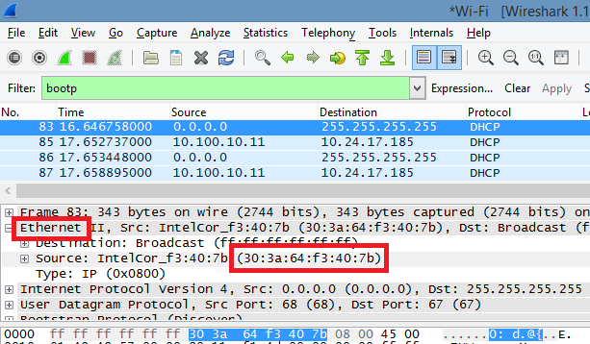
What is the link‐layer (e.g., Ethernet) address of your host?
(30:3a:64:f3:40:7b)

Slide 57


What values in the DHCP discover message differentiate this message from the DHCP request message?
DHCP: Discover value

Slide 58

What is the value of the Transaction‐ID in each of the first four (Discover/Offer/Request/ACK) DHCP messages? What are the values of the Transaction‐ID in the second set (Request/ACK) set of DHCP messages? What is the purpose of the Transaction‐ID field?
0x6ffbbc4a
0x82cad2d
The transaction ID identifies messages as part of a group of messages

Slide 59

What is the IP address of your DHCP server?
10.100.10.11

Slide 60

What IP address is the DHCP server offering to your host in the DHCP Offer message? Indicate which DHCP message contains the offered DHCP address to clarify.
10.24.17.185

Slide 61
Sources
http://it.iut.ac.ir/sites/fsites/it/files/u4/uploads/Networking%20Class-Wireshar%20Labs-Solutions/07-Wireshark_ICMP_Solution_July_22_2007.pdf
https://docs.google.com/document/d/1oks_EvCPndAYCTQswmQHfjewnPt31f1QNSXr8Vs7gdo/edit
https://msdn.microsoft.com/en-us/library/windows/desktop/aa380513(v=vs.85).aspx

